Slide 1


Slide 2
COCOMO
Boehm [1981] proposed the Constructive Cost Model (known as COCOMO model). The model proposed by him was the result of data analysis of 63 projects .
The data base used included:
Programms written in various high level languages (like FORTRAN COBOL etc) and assembly level languages.
program sizes varying from 2 KDSI to 900 KDSI.
application areas encompassing scientific and business sectors.

Slide 3
COCOMO :COnstructive COst MOdel:
The COCOMO model estimates the overall effort in terms of person month as well as the development time and schedule.
It also breaks down the overall effort into phases and activities and the associated cost for each phase separately.

Slide 4
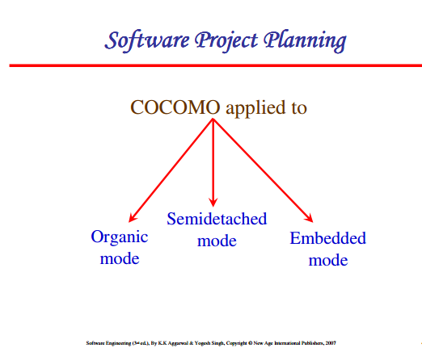

Slide 5
COCOMO Modes
Development project modes are Organic, Embedded or Semi-detached.
The Organic development mode has the following features
  Small and comparatively simple project
  relaxed delivery requirement
  stable in-house development environment
  dependence on other systems are minimal and may run by itself.

Slide 6
COCOMO Modes
Development project modes are Organic, Embedded or Semi-detached.
The Embedded mode has the following features
  Relatively large project and hard timing constraints are to be met
  Substantial interaction between custom hardware and software
  Complex user interface design

Slide 7
COCOMO Modes
Development project modes are Organic, Embedded or Semi-detached.
The Semi- detached mode is in between the two.

Slide 8
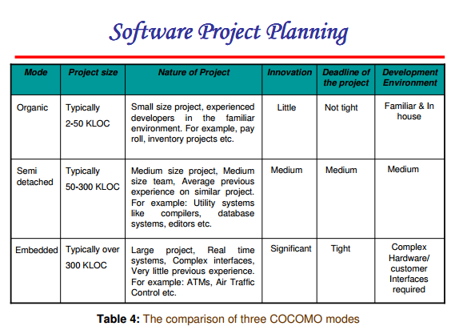

Slide 9
Levels of COCOMO
Depending on the details to be incorporated in the cost estimation, the COCOMO model has three levels known as Basic, Intermediate and Detailed.
In Each of the levels, the nominal development effort (Enom) had been estimated using the relation in the form
Enom = a . S^{b}

Slide 10
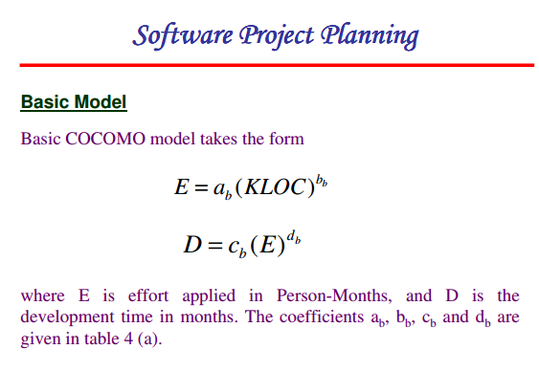

Slide 11
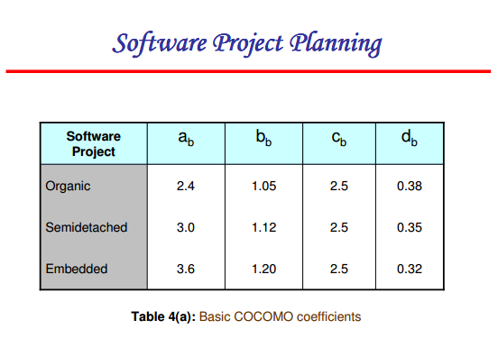
Table 4a to be learnt by Heart

Slide 12

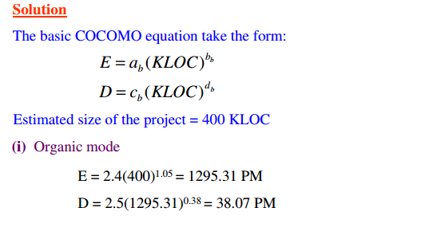
Pls Note: Units of Development Time is months

Slide 13
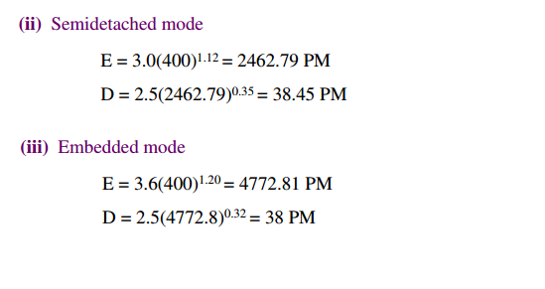
Pls Note: Units of Development Time is months

Slide 14
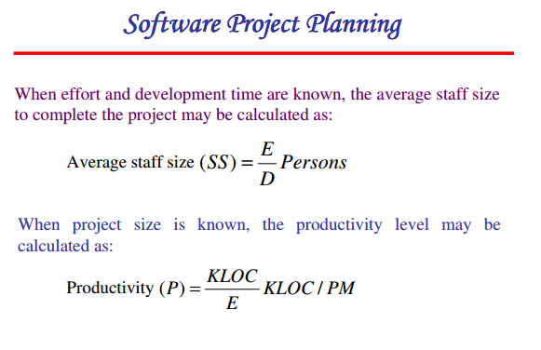

Slide 15

